Slide 1
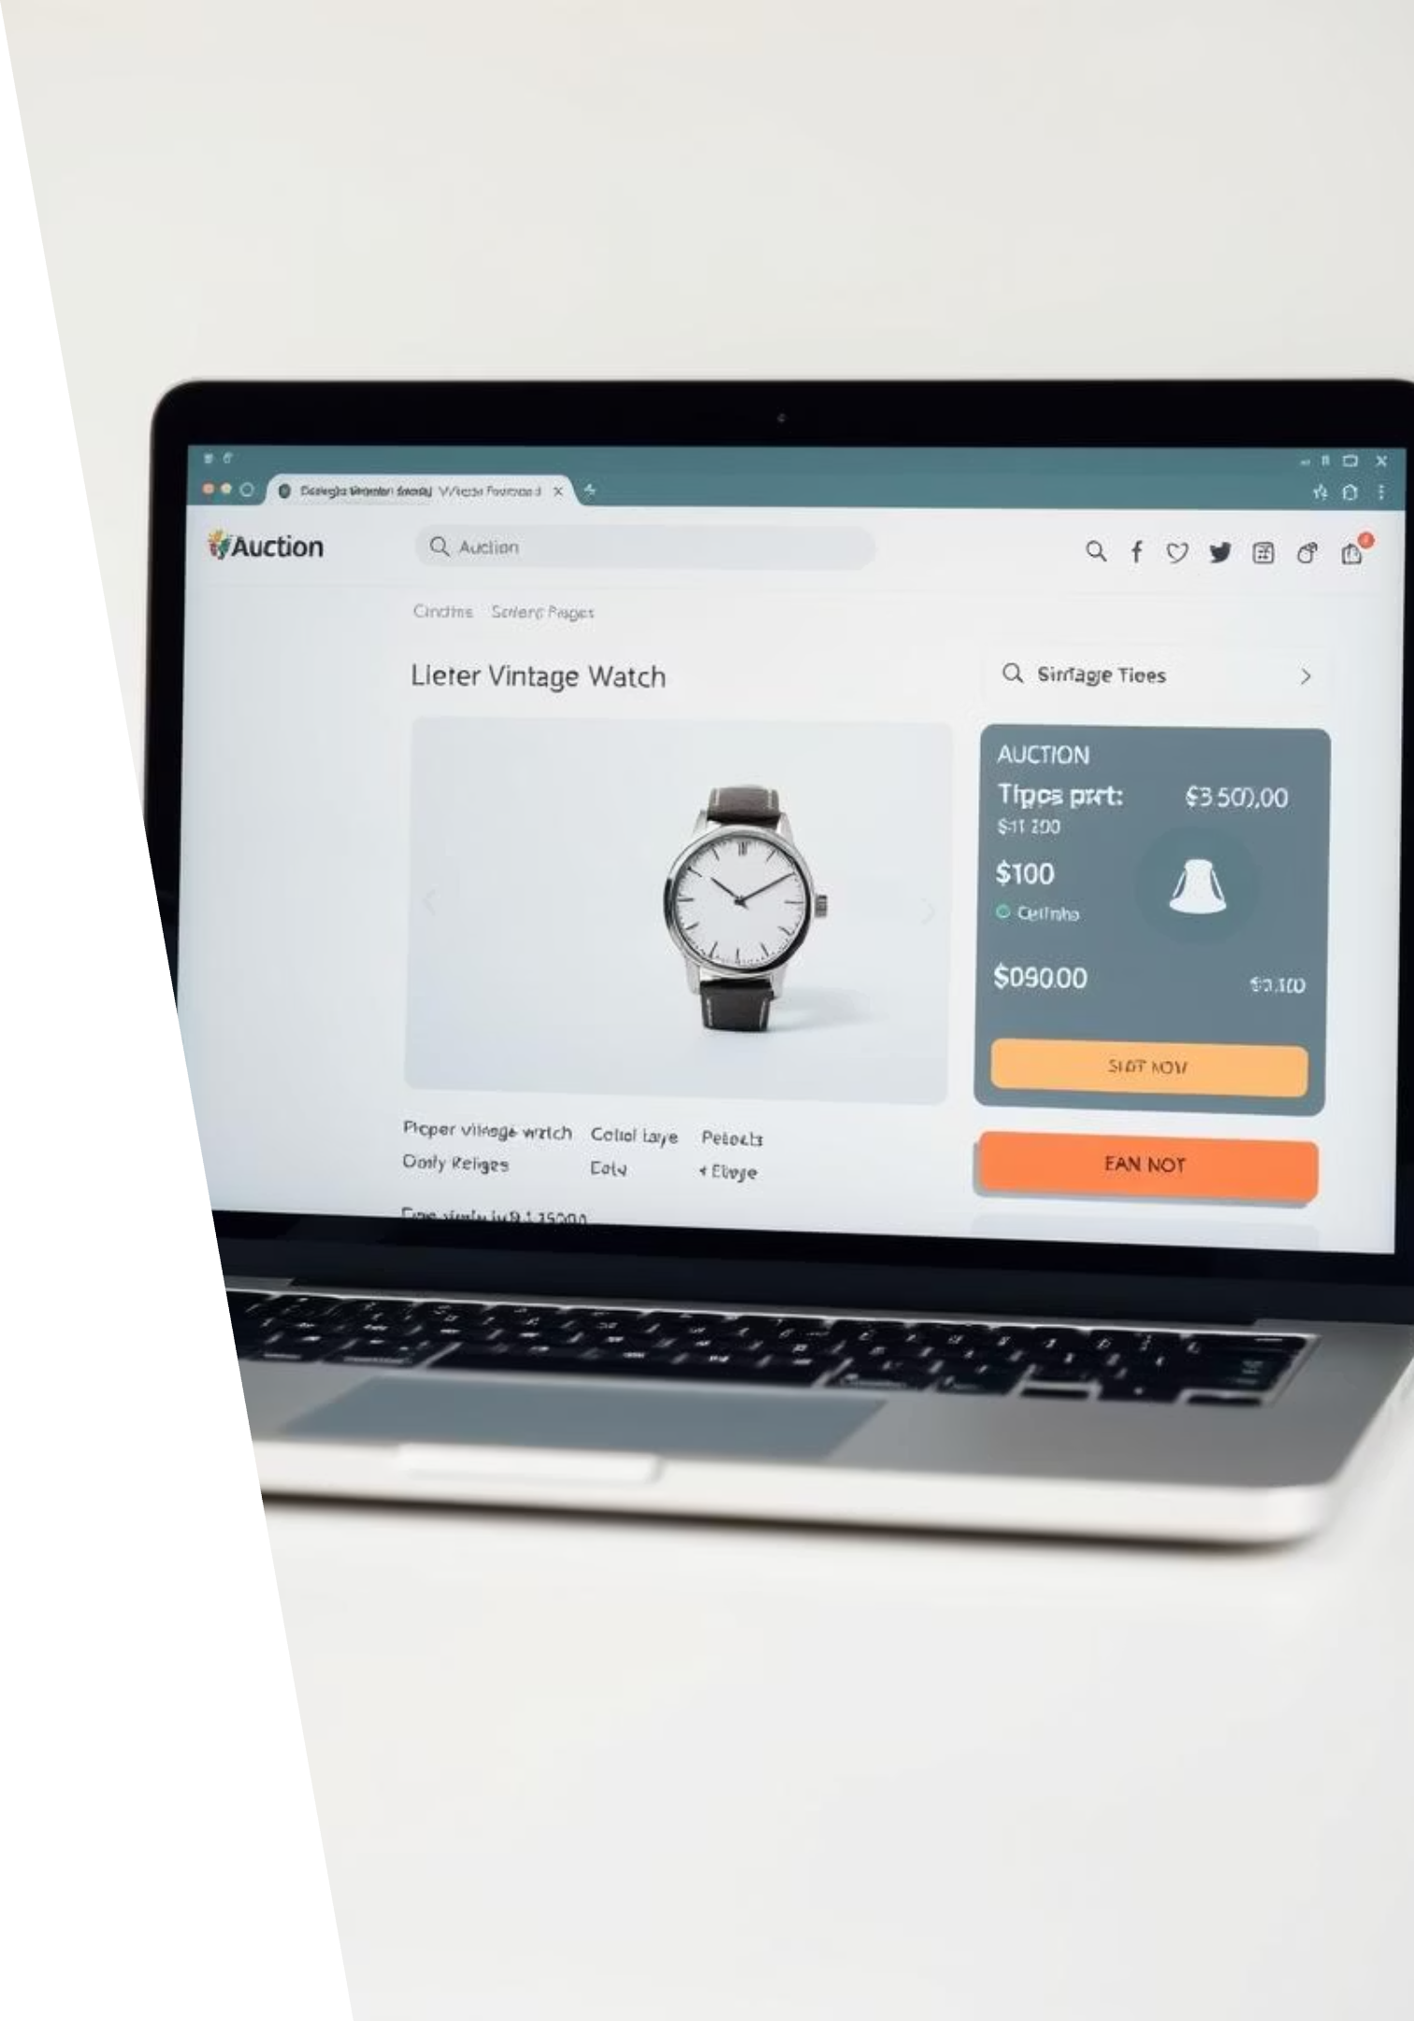
Online Auction System: Low-Level Design

Slide 2

Agenda: Understanding the System's Inner Workings
01
02
System Overview
Frontend Deep Dive
High-level architecture and component decomposition.
ReactJS components and state management strategies.
03
04
Backend Deep Dive
Database Essentials
Spring Boot APIs, services, and data flows.
MySQL schema and key entity relationships.
05
06
Key Process Walkthrough
Critical Considerations
Detailed look at the bidding process.
Security, scalability, and future enhancements.

Slide 3
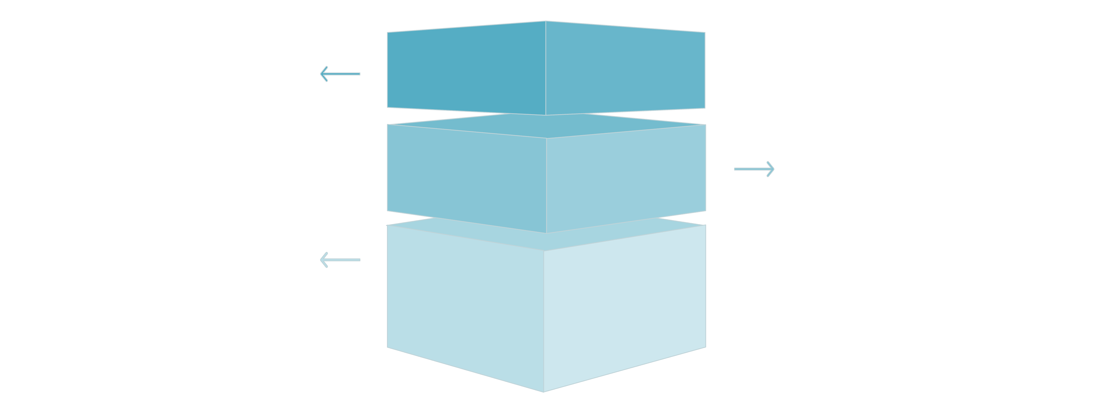
Overall System Architecture: Decomposing the Auction Platform
Our Online Auction System adopts a layered, microservices-oriented architecture to ensure modularity, scalability, and maintainability. This structure clearly separates concerns, allowing for independent development and deployment of key functionalities.
ReactJS Frontend
User interface and client-side logic, calls REST API.
Spring Boot Backend
Business services and REST endpoints, handles requests.
MySQL Database
Persistent storage accessed via JDBC/JPA.
Frontend (ReactJS): User interface and interaction layer.
Backend (Spring Boot): Business logic, API endpoints, and data access orchestration.
Database (MySQL): Persistent storage for all auction data.
REST APIs: The primary communication channel between frontend and backend.

Slide 4

Frontend LLD (ReactJS): Component Design & State Management
The ReactJS frontend is designed around a modular component-based architecture, promoting reusability and maintainability. Key components include:
Authentication: Login, Registration, Password Reset.
Product Listing: Browse Items, Search, Filters.
Auction Item: Item Details, Current Bid, Bid History, Countdown Timer.
Bidding Controls: Place Bid, Autobid.
User Dashboard: My Bids, My Listings, Notifications.
State management will be handled primarily by React Context API for global states (e.g., user authentication, shopping cart), supplemented by local component state for UI-specific data. For complex asynchronous operations and side effects, Redux Toolkit or React Query will be evaluated for efficient data fetching and caching.

Slide 5
Backend LLD (Spring Boot): API Design & Service Layer Architecture
Our Spring Boot backend is structured with a clear separation of concerns, ensuring a robust and scalable API. The Service Layer orchestrates business logic and interacts with the Data Access Layer, while RESTful Controllers handle incoming requests and map them to appropriate service methods.
RESTful Endpoints
Service Layer
Standardized API routes for items, bids, users, and authentication (e.g., /api/v1/items/{id}, /api/v1/bids).
Contains core business logic. Examples: ItemService, BidService, UserService.
Data Transfer Objects (DTOs)
Security
Used for safe data exchange between layers, preventing direct exposure of entities.
Leverages Spring Security for authentication (JWT) and authorization.
Each service method is designed to be atomic, handling specific business operations and ensuring transactional integrity.

Slide 6
Backend LLD (Spring Boot): Data Access & Business Logic Flows
The Data Access Layer (DAL) utilizes Spring Data JPA, providing a powerful abstraction over JDBC for seamless interaction with the MySQL database. Repositories define methods for CRUD operations, and custom queries can be added as needed.
Key business logic flows:
Placing a Bid:
Validate bid amount against current highest bid.
Check auction status (active, not ended).
Entities: Java POJOs mapped to database tables (e.g., Item, User, Bid).
Update highest bid and bid history.
Notify relevant parties (previous bidder, item owner).
Repositories: Interfaces extending JpaRepository for data access methods.
Ending an Auction:
Triggered by cron job or countdown timer.
Transactions: Managed via Spring's declarative transaction management (@Transactional).
Determine winner based on highest bid.
Update item status to "sold" or "ended".
Generate invoice/notification for winner and seller.

Slide 7

Key Module Walkthrough: The Bidding Process Flow
The bidding process is central to the auction system. This flow outlines the sequence of interactions from the user's action to the database update and subsequent notifications.
1. User Places Bid
Frontend sends a POST request to /api/v1/bids with item_id and bid_amount.
2. Backend Validation
BidService validates bid_amount (must be > current highest bid, > minimum increment) and auction status.
3. Database Update
If valid, BidRepository saves the new bid; ItemRepository updates current_bid and highest_bidder_id (transactionally).
4. Real-time Update & Notify
Backend sends WebSocket notification to all active bidders and item page. Previous highest bidder receives outbid notification.
5. Frontend Rerender
Frontend receives WebSocket update and rerenders the item component to reflect the new highest bid.

Slide 8
Security & Scalability Considerations at LLD
Security Measures
Scalability Measures
Authentication: JWT-based authentication for stateless API security, managed by Spring Security.
Stateless Services: Backend services are stateless, allowing for easy horizontal scaling.
Authorization: Role-based access control (RBAC) to restrict actions (e.g., only seller can edit item).
Database Optimization: Indexing key columns, connection pooling (HikariCP), and query optimization.
Input Validation: Extensive server-side validation to prevent injection attacks and malformed data.
Caching: Implement caching layers (e.g., Redis) for frequently accessed, immutable data (e.g., categories, popular items).
Data Encryption: Passwords stored as bcrypt hashes; sensitive data encrypted at rest and in transit (HTTPS).
Asynchronous Processing: Use message queues (e.g., RabbitMQ, Kafka) for non-critical operations like email notifications, freeing up main threads.
Rate Limiting: Implement API rate limiting to prevent brute-force attacks and abuse.
WebSockets: For real-time updates (e.g., live bids) to reduce polling overhead.

